Slide 1
NETWORKING 101
What is a network?
Why so many devices in networking?
What are the concerns and motivations behind the development of a Switch?
Collision domain, Duplex and how a Switch actually works?
Network language and how hosts communicate with each other
Data link layer? What is the problem it’s trying to solve and how?
What is Ethernet?
LAN/VLAN
What is LAN?
What are the concerns and motivations behind the development of VLAN?
How hosts communicate with each other in VLAN?
Technical aspects of VLAN communication
Native VLAN
Everything hosts do to communicate in a network

Slide 2
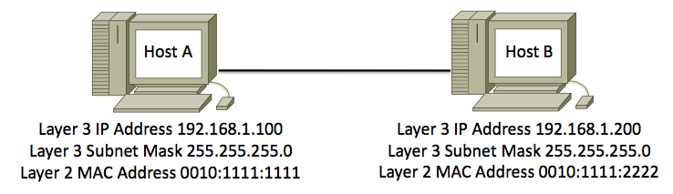
1. What is a network
A connection between two or more computers that are linked to share resources.
Connection -> Logical Configuration.
Computer -> Hosts (server or client).
Linked -> Physical Configuration.
Everything you learn from this point onward is solution to problems network may have

Slide 3
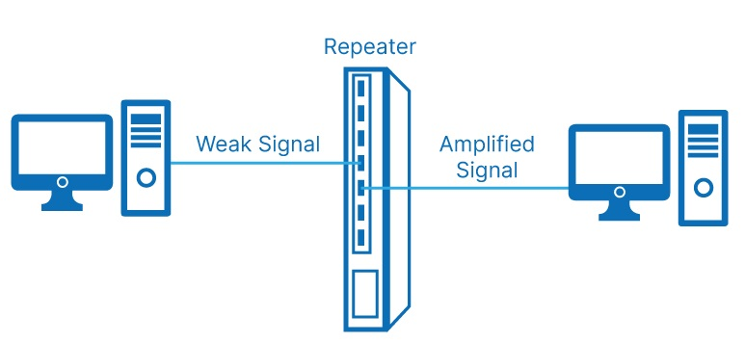
2. Why so many devices in networking?
Because network has so many problems that required solutions.
What if we want our network to span over a larger distance

Slide 4
2. Why so many devices in networking? (Cont)
What if we want better scale in our network
Hub is a multi-port repeater

Slide 5
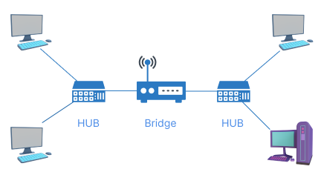
2. Why so many devices in networking? (Cont)
What if we want better security and performance for hosts
Sort of… But diversification and management requirements wants better solution
Is the problem about performance and security solved?

Slide 6
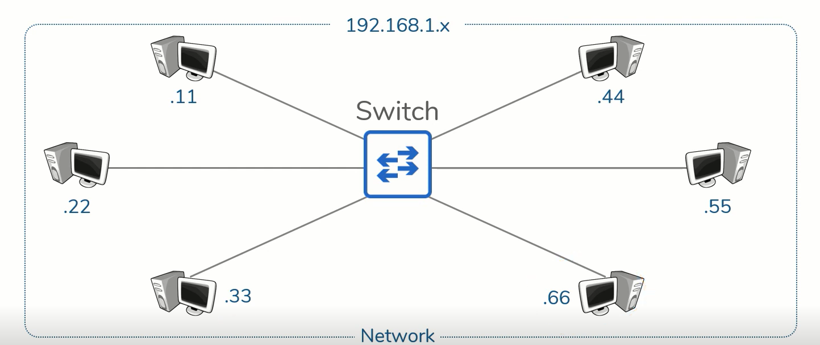
3. Concerns and motivations for developing a Switch
Combination of Hubs and Bridges
Multi-port and connection is transfer on a per-port-basis
Switches facilitates communication within a network

Slide 7
4. Collision domain, Duplex and how a Switch actually works?
A Collision domain is a network segment connected by a shared medium
What is the concern of collision domain? -> Half-duplex and collision
Half-duplex means a host can at a same time transmitting or receiving data, not both.
Collisions means data from two hosts collides.

Slide 8
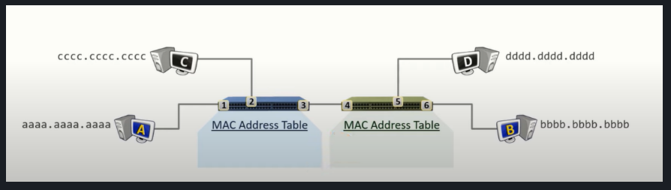
4. Collision domain, Duplex and how a Switch actually works?
Address Resolution Protocol (ARP) is a process of mapping MAC address with IP address, stored in ARP
cache.
Switches only perform 3 action: Learn, Flood, Forward
Switches use and maintain MAC address table, which is a mapping of Switch ports to MAC address.
Unicast Frame: is when the destination is another host.
Broadcast Frame: is when the destination is FFFF.FFFF.FFFF.

Slide 9
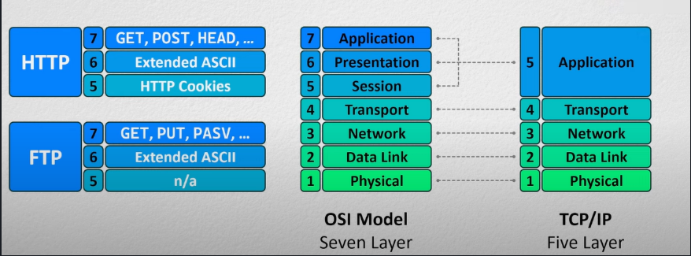
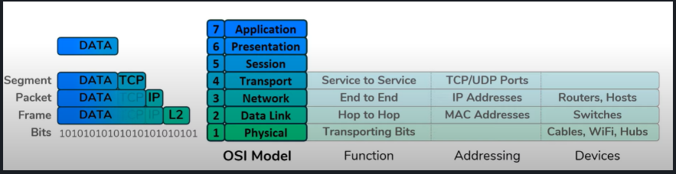
5. Network language and how host communicate
In networking, bits are letters, Layers are words, and Protocol are languages.
What a Layer can do depends on its bit formation, like the words you read depends on how you structured letters
Protocol Data Unit (PDU) is how bits are formatted and used, like how letters are assembled into words.

Slide 10
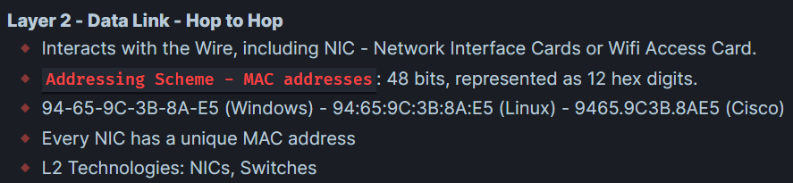
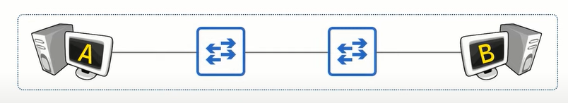
6. Data Link Layer, what is the problem it is trying to solve and how?

Slide 11
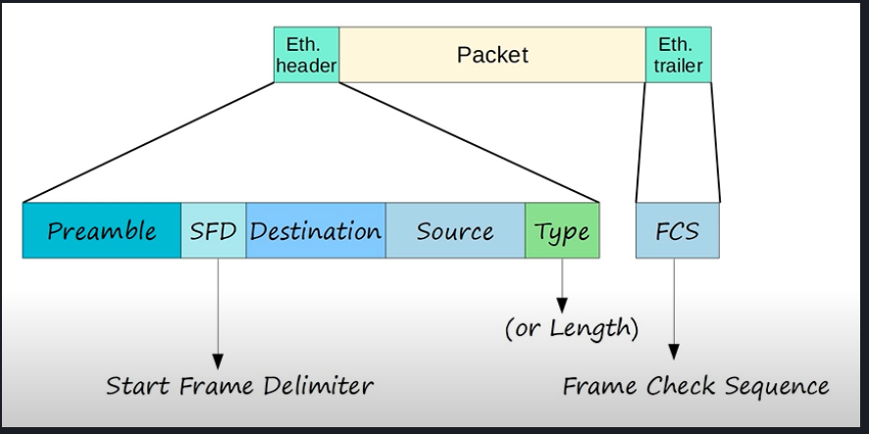
7. What is Ethernet
A set of standards aims to solved packet collision, essentially bit formation for Layer 2 (not the only one, the most famous one).

Slide 12
1. What is a LAN
Local Area Network (LAN) is a collection of devices connected together in one physical location.

Slide 13
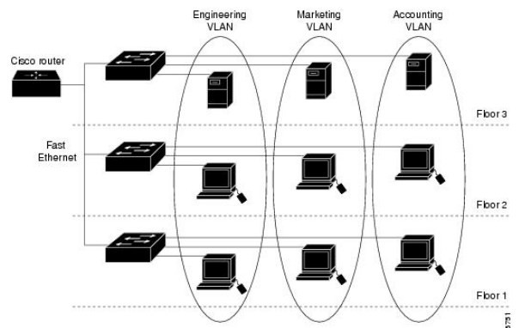
2. What are the concerns and motivations behind the development of VLAN
Virtual Local Area Network (VLAN) is logical grouping of devices that share a physical LAN.

Slide 14
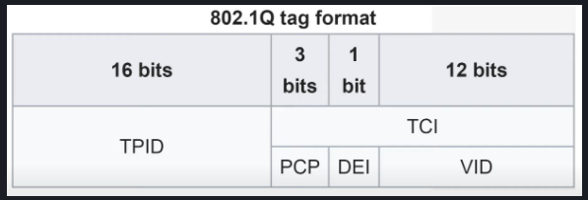
3 + 4: Technical aspects of VLAN
Trunk port is used to carry data from multiple VLANs using one interface.

Slide 15
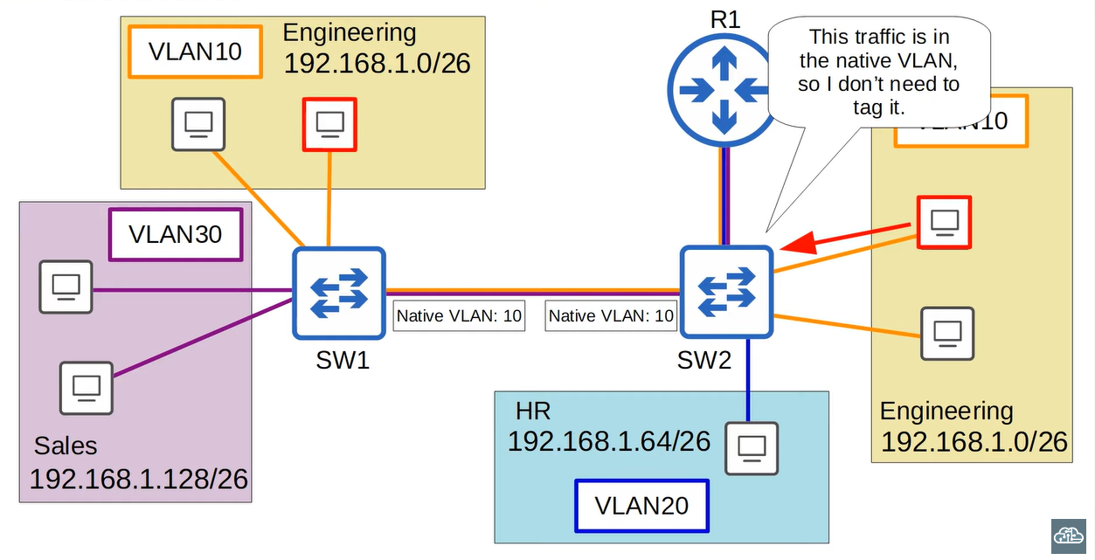
5. Native VLAN
Switch does not add an 802.1Q tag to frame in Native VLAN. It is important that native VLANs between switches
Match

Slide 16
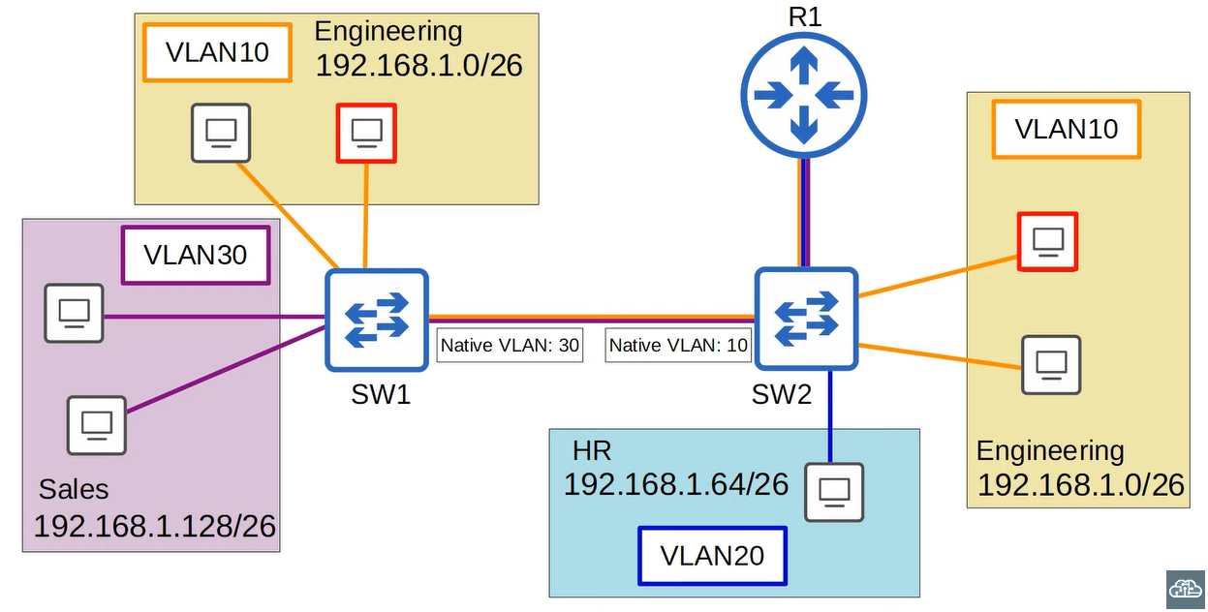
5. Native VLAN (cont)

Slide 17
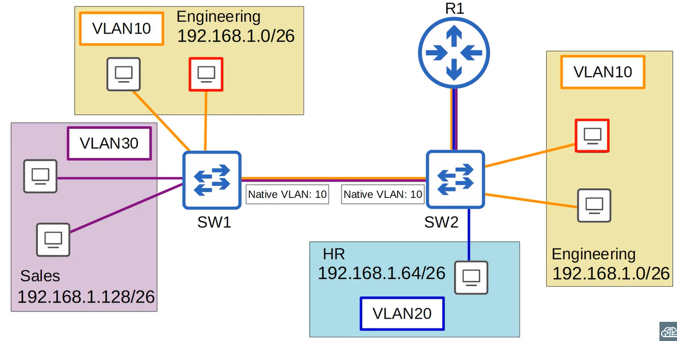
6. Everything Hosts need to do to communicate

